Slide 1
UNITY PROJECT
3D MARIO
陳聖泓 F74104016
張禕倫 F74101262
陳廷睿 F74101034
GROUP14
組員

Slide 2
TABLE OF CONTENTS
01
THEME
02
IDEA
03
Teamwork
04
DEMO

Slide 3
01
THEME
3D MARIO

Slide 4
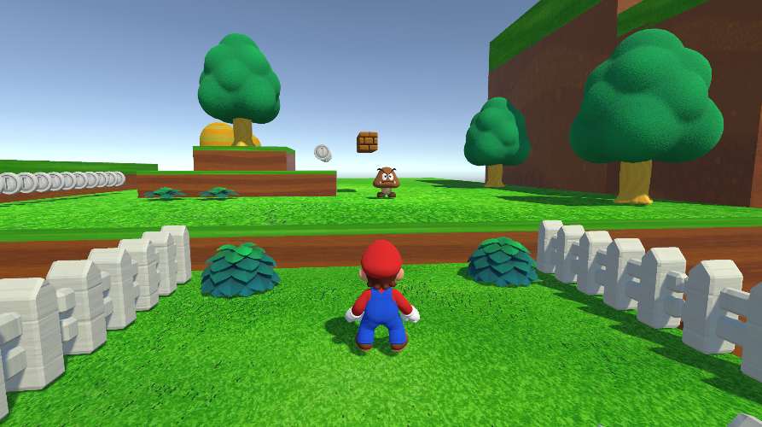
3D MARIO
我們都很喜歡玩馬力歐 之前也常窩在宿舍熬夜遊玩 想重溫當年的美好回憶
期許我們能做出相似度高的作品
3D

Slide 5
02
IDEA

Slide 6
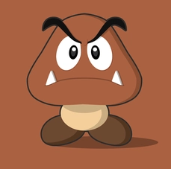


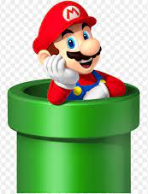
IDEA
Goomba
FLAG
Props
Moving Scene
Pipe
Stepping on it to kill
Place flag to win
Multiple props on road to flag
Not static
Move instantly to another place

Slide 7
03
TEAMWORK

Slide 8
Division of work
陳聖泓：環境架構、人物移動、視角、關卡設計、道具佈置 、音效
張禕倫：玩家部分動作、Menu scene、錢幣動畫、UI、Pipe
陳廷睿：栗子怪動作、蘑菇道具、Flag、Moving Scene 、Bouncing Pad
共同：遊戲發想、細節優化

Slide 9
Done
Progress
Scenes
Movement
Animator
Music
Enemy
Send player through pipe
Bigger by mushroom
Break brick
Endpoint-flag
Get star&coin
Moving scene
Nice environment
100%

Slide 10
04
DEMO

Slide 11
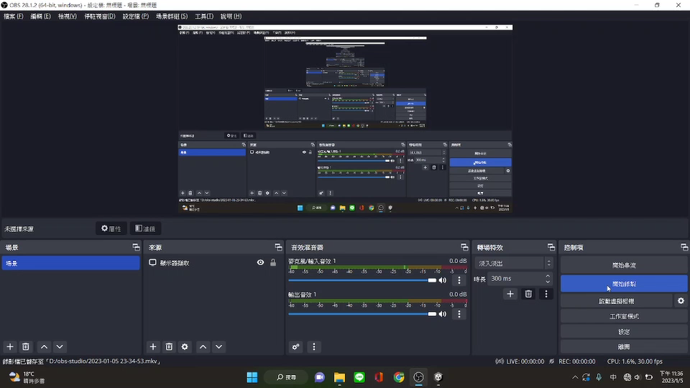
DEMO
VIDEO

